Slide 1
CMSC 603
High-Performance Distributed Systems
Java parallelism and RMI
Dr. Preetam Ghosh
Professor
Department of Computer Science
pghosh@vcu.edu

Slide 2

CMSC 603 - HPDS
Java parallelism and RMI
Java threads: Runnable interface
  Provide a Runnable object. The Runnable interface defines a single method, run, meant to contain the code executed in the thread
  The Runnable object is passed to the Thread constructor
  start and join control the beginning and end of the thread
public class HelloRunnable implements Runnable {
public void run() {
System.out.println("Hello from a thread!");
}
public static void main(String args[]) throws Exception {
Thread t = new Thread(new HelloRunnable());
t.start();
t.join();
}
}
Example: HelloRunnable.java

Slide 3
CMSC 603 - HPDS
Java parallelism and RMI
Java threads: Thread class inheritance
  The Thread class itself implements Runnable
  An application can subclass Thread, providing its own implementation of the run method
public class HelloThread extends Thread {
public void run() {
System.out.println("Hello from a thread!");
}
public static void main(String args[]) throws Exception {
HelloThread t = new HelloThread();
t.start();
t.join();
}
}
Example: HelloThread.java

Slide 4
CMSC 603 - HPDS
Java parallelism and RMI
Thread priorities and scheduling
  Threads have priority from 1 to 10
    Thread.MIN_PRIORITY 1
    Thread.NORM_PRIORITY 5 (default)
    Thread.MAX_PRIORITY 10
  New threads inherit priority of thread that created it
public void run(){
int priority = Thread.currentThread().getPriority();
}
public static void main(String args[]) throws Exception {
Thread t1 = new Thread();
Thread t2 = new Thread();
t1.setPriority(Thread.MIN_PRIORITY);
t2.setPriority(Thread.MAX_PRIORITY);
t1.start();
t2.start();
}
Example: ThreadsPriority.java

Slide 5
CMSC 603 - HPDS
Java parallelism and RMI
Synchronized methods
  Synchronized is used to lock an object for any shared resource
  When a thread invokes a synchronized method, it automatically acquires the lock for that object and releases it when the thread completes its task
  Also valid for static synchronized methods
public class SynchronizedCounter {
private int c = 0;
public synchronized void increment() {
c++;
}
public synchronized int value() {
return c;
}
}
Example: SynchronizedMethod.java

Slide 6
CMSC 603 - HPDS
Java parallelism and RMI
Synchronized statements / blocks
  Unlike synchronized methods, synchronized statements must specify the object that provides the intrinsic lock (monitor)
  Synchronized block is better than synchronized method because by using synchronized block you only lock critical section and avoid locking the whole method which can possibly degrade the performance of the parallel application
  It is even possible to use synchronized blocks inside a Lambda Expression as well as inside anonymous classes
public class SynchronizedCounter {
private int c = 0;
public void increment() {
synchronized(this){
c++;
}
}
}
Example: SynchronizedBlock.java

Slide 7
CMSC 603 - HPDS
Java parallelism and RMI
Atomic access
  Package java.util.concurrent.atomic provides a small toolkit of classes that support lock-free thread-safe programming on variables
  Examples: AtomicInteger, AtomicReference<V>
volatile keyword
  Used to indicate that a variable's value will be modified by threads
  The value of this variable will never be cached thread-locally
  In case only one thread reads and writes the value of a volatile variable and other threads only read the variable, then the reading threads are guaranteed to see the latest value of the volatile variable (1 Write, Many Read, OK)
  Does NOT protect from race conditions (when multiple threads write)
Examples: AtomicIntegerExample.java and AtomicReferenceExample.java

Slide 8
CMSC 603 - HPDS
Java parallelism and RMI
Locks
  Java.util.concurrent.locks.Lock is a thread synchronization mechanism = synchronized blocks
  First a Lock is created. Then it’s lock() method is called and the Lock instance is locked. Any other thread calling lock() will be blocked until the thread that locked the lock calls unlock(). Finally unlock() is called, and the Lock is now unlocked so other threads can lock it
private int c = 0;
private Lock lock = new ReentrantLock();
public void increment() {
lock.lock();
c++;
lock.unlock();
}
public int value() { return c; }
Example: LockCounter.java

Slide 9
CMSC 603 - HPDS
Java parallelism and RMI
Semaphores
  A Semaphore is a thread synchronization construct that can be used either to send signals between threads to avoid missed signals, or to guard a critical section like a lock
  Binary or counter semaphores
  acquire and release methods control the signaling
private int c = 0;
private Semaphore semaphore = new Semaphore(1);
public void increment() {
try {
semaphore.acquire();
c++;
semaphore.release();
} catch (Exception e) { … }
}
Examples: SemaphoreCounter.java
Which is faster?
SynchronizationPerformance.java

Slide 10
CMSC 603 - HPDS
Java parallelism and RMI
Thread Pools
  Useful when you need to limit the number of threads running
  Instead of starting a new thread for every task to execute concurrently, the task is passed to a pool. As soon as the pool has any idle threads the task is assigned to one of them and executed.
ExecutorService executorService = Executors.newFixedThreadPool(10);
executorService.execute(new Runnable() {
public void run() {
System.out.println("Asynchronous task");
}
});
executorService.shutdown();
Example: ThreadPool.java

Slide 11
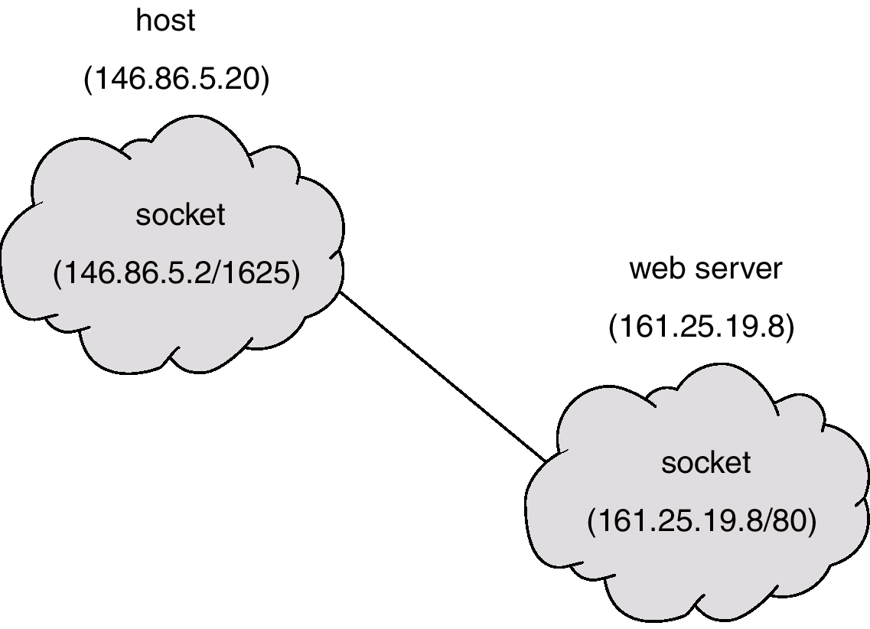
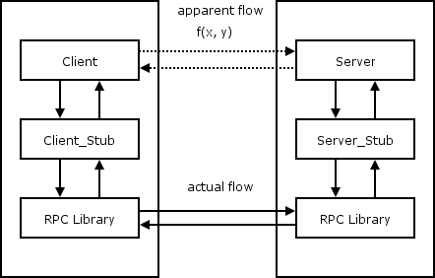
CMSC 603 - HPDS
Java parallelism and RMI
Client-server communication
  Sockets
    Low-level endpoint for communication: IP + port
    Send / recv methods: protocol
    Semantics of the communication given by coder
  Remote Procedure Call (RPC)
    Protocol to request a service from a program located in another computer in a network
    Useful to call functions remotely

Slide 12
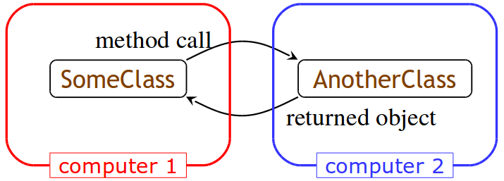
CMSC 603 - HPDS
Java parallelism and RMI
Remote method invocation technologies
  CORBA (Common Object Request Broker Architecture)
    CORBA supports object transmission between any languages
    Objects described using IDL (Interface Definition Language)
    CORBA is complex and flaky
  Java RMI (Remote Method Invocation)
    Java to Java communications only, much simpler than CORBA

Slide 13
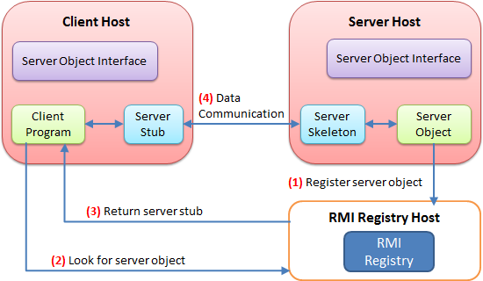
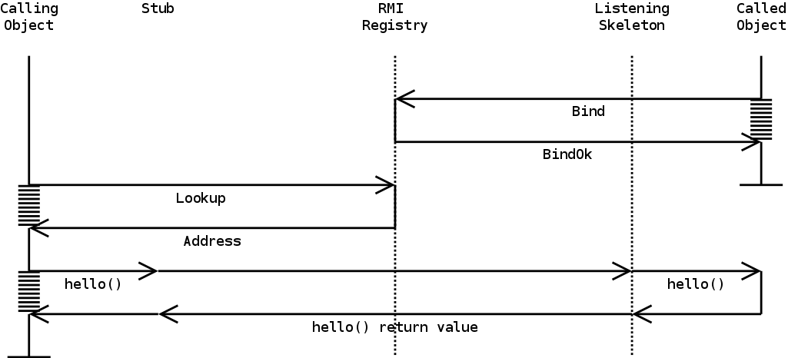
CMSC 603 - HPDS
Java parallelism and RMI
Java RMI architecture
Client
Server
Server interface
Server object
RMI registry

Slide 14
CMSC 603 - HPDS
Java parallelism and RMI
Java RMI architecture
  In order to use a remote object, the client must know its behavior (interface), but does not need to know its implementation (class)
  In order to provide an object, the server must know both its interface (behavior) and its implementation (class)
  Adds a layer of security to hide the implementation of a service remotely
  A Remote interface is one whose instances can be accessed remotely
  A Serializable class is one whose instances can be marshaled (turned into a linear sequence of bits) and transmitted from one computer to another. The class must implement Serializable.

Slide 15
CMSC 603 - HPDS
Java parallelism and RMI
Java RMI architecture: Remote server
  You can send messages to a Remote object and get responses back
  All you need to know about the Remote object is its interface
  You can transmit a copy of a Serializable object between computers
  The server class should extend UnicastRemoteObject
  The server class needs to register its server object:
String url = "rmi://" + host + ":" + port + "/" + objectName;
Naming.rebind(url, serverObject);
// default port 1099
// host name should be accessible by the clients

Slide 16
CMSC 603 - HPDS
Java parallelism and RMI
Hello world using RMI
  Server interface
  Server object
public interface HelloWorldInterface extends Remote {
public String sayHello(String name) throws RemoteException;
}
public class HelloWorldServer
extends UnicastRemoteObject implements HelloWorldInterface {
public String sayHello(String name) throws RemoteException {
return "Hello " + name;
// String for input and return are serializable
}
}

Slide 17
CMSC 603 - HPDS
Java parallelism and RMI
Hello world using RMI
  Server class
  Client class
public class HelloServer {
public static void main (String[] args) throws Exception {
Naming.rebind("rmi://hostname/HelloWorldServer",
new HelloWorldServer());
}
}
public class HelloClient {
public static void main (String[] args) throws Exception {
HelloWorldInterface hello;
String name = "rmi://hostname/HelloWorldServer";
hello = (HelloWorldInterface) Naming.lookup(name);
System.out.println(hello.sayHello("Alberto"));
}
}

Slide 18
CMSC 603 - HPDS
Java parallelism and RMI
Running the registry, server, and client
  Run the registry at the server (locate at bin path): rmiregistry
  Run the server program at the server: java HelloServer
  Run the client program at the client: java HelloClient
Summary
  Start the registry server, rmiregistry
  Start the object server, the server registers an object in the registry
  Start the client, the client looks up the object in the registry, makes a request
  The Stub classes on client and server talk to each other
  EXTREMELY useful for remote procedures / distributed computing / botnet

Slide 19
CMSC 603
High-Performance Distributed Systems
Java parallelism and RMI
Dr. Preetam Ghosh
Professor
Department of Computer Science
pghosh@vcu.edu

